Slide 2
Our Mission
In today’s fast growing lifestyle everyone is running to achieve their goal within the minimum time span. Whether it is in Asia , Europe, U.S.A., China or any other continent, we found this race is going-on among all the people of this world. In today’s modern era the whole world is like a global-village, as a result day by day competition in every aspect of life is getting tough.
The pressure of modern life-style affecting us in various way whether it is physical or psychological. We have time for everything , but not able to manage an hour from our daily busy schedule to enhance our physical or psychological growth. NO GYM BE SLIM, LLC is not a simple business venture, it is an effort to make the world understand and help to achieve a healthy life and stress free mind, without investing much time and efforts.

Slide 3
Our vision
Our Vision is to restored the health of all human being and help others to make all human being happy.

Slide 4
Our values
Nature and Music are the two wonderful blessings of The Almighty to humanity, which are helping for the development of our ancestors from the early age of civilization. Since the early era of human civilization, so many research has proved the fact that Naturopathy and Music-therapy helps us in the development our Physical, Psychological, Emotional, Spiritual and Philosophical aspects. Human civilization cannot be possible without Nature and Music.
Thousands of years ago all these form of treatment has been scientifically proven by our ancestors. We the team of NGBS is putting our best effort to get the people closer to their original form of treatment.

Slide 5
“From the unreal lead me to the real, from the dark lead me to the light.”
The internal meaning of the above line is – “enhance the energy which is lying inside you , you can only achieve the goal of your life once you’ll be able to enlighten your soul”.
If we talk about any other religion whether it is Christianity, Islam or Buddhist , the internal message of all the religion is same . Until you’ll not enlighten your internal power of energy, you’ll not be able to achieve anything in life.
In above respect our sincere effort is to help the people to get their desired life with the help of oldest form of treatment and that is “Naturopathy, Meditation and Music”.

Slide 6
The term Naturopathy is derived from Latin and Greek, and literally translates as “natures disease”. Modern naturopathy grew out of the Natural Cure movement of Europe. The term was coined in 1895 by John Scheel and popularized by Benedict Lust, the & “father of U.S. Naturopathy”. Naturopathy or naturopathic medicine is employing a wide array of natural treatments, including verbalism, and acupuncture, as well as diet and lifestyle counseling.

Slide 7
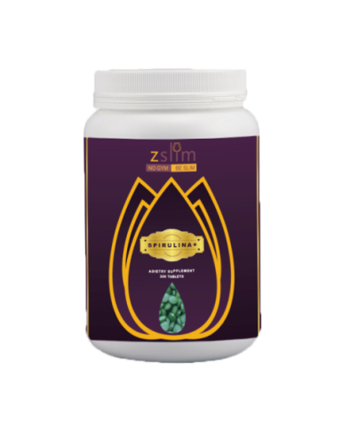
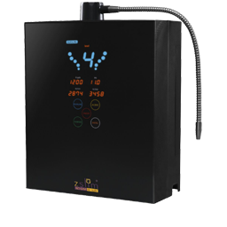
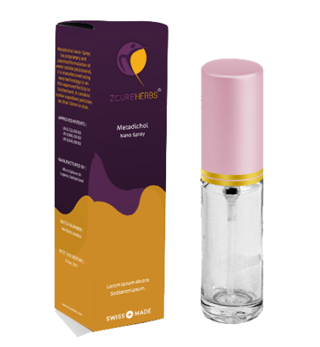
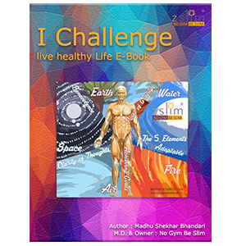
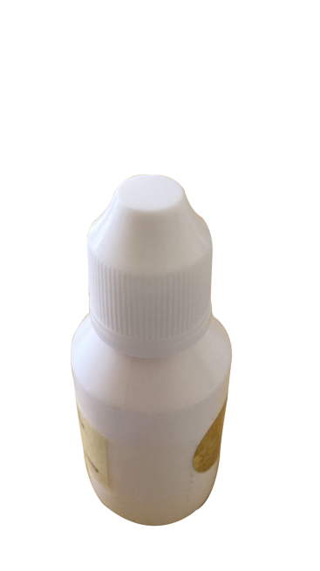
Our products
Spirulina +
Zcure spray
NGBS Alkaline
Anti-Oxident Healing Structured Water Ionizer
I CHALLENGE BOOK
Nano Curcumin

Slide 8
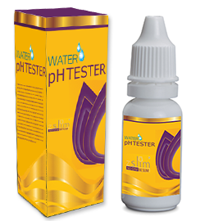
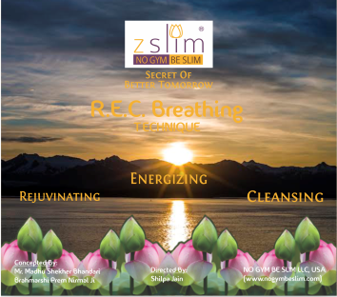
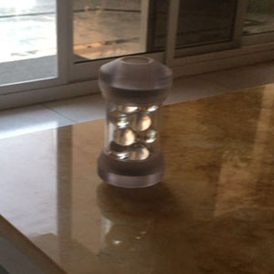
Our products
Dietician
Ph Tester
R.E.C. BREATHING technique
The 5 ELEMENTS
(Audio)
Antioxident alkaline Healing structured water

Slide 9
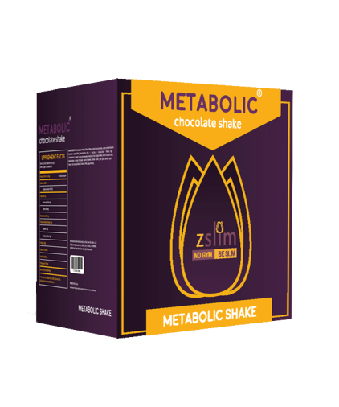
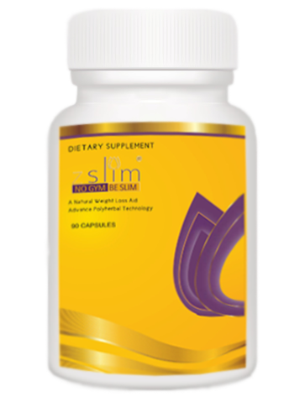
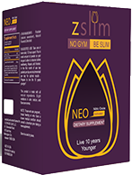
Our upcoming products
z.Slim capsules
Nitric oxide
metabolic

Slide 10
NGBS Alkaline Anti-Oxident Healing Structured Water Ionizer
There are various types of water in the world, however we proudly assure that NGBS Alkaline Anti-Oxident Healing Structured Water Ionizer is unique and truly beneficial for your body. We hope that you can improve your health with NGBS Alkaline Anti-Oxident Healing Structured Water Ionizer. You can maintain a healthy lifestyle utilizing all five of our waters described below. True Health is not only maintained through the water we consume but with all the water we use in our daily lives water for drinking, cooking, personal care, general cleansing and sanitation. We invite you to join our happy human network of True Health and experience the many uses of Kangen Water.

Slide 11
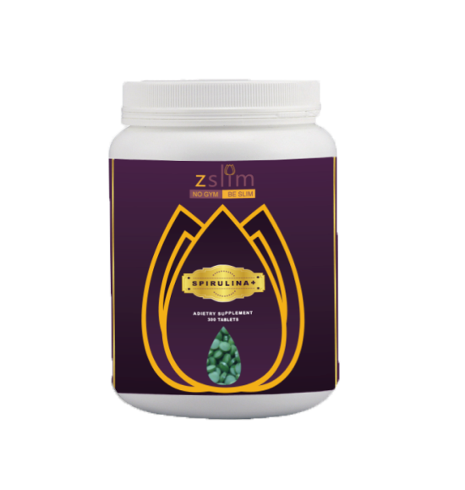
SPIRULINA +
Spirulina + Enriched by the Deep Ocean Water Thanks to long years of research, experience and high level technology. This breakthrough is a world-first in the production of Spirulina +. Deep sea water contains approximately 85 vitamins and mineral beneficial for human health and longevity .After long years of research at its laboratories, NGBS, succeeded in developing a way to condense these rich mineral and nutrients found deep in the sea and has made them available to human beings for the first time in a food supplement containing a high concentration of minerals.
Cultivated solely in pristine water taken from a depth of 612 meters off the coast of Kumejima Island near Okinava, this “Seaweed of eternal youth” absorbs the water’s rich nutrients and minerals, growing 3-5 times the size of ordinary Spirulina +. In a report of experiment it conducted to determine the effects of deep ocean water on the longevity of mice, the National Food Research Institute, Ministry of Agriculture, Japan also indicated that deep sea water was a sources of life.

Slide 12
SPIRULINA +
Interestingly, the Japanese legend of Urashima Taro tells about a man who visits’ the kingdom beneath the sea and stays there for hundreds of years without ageing a single day. Is this legend perhaps suggesting that the secret of longevity can be found in deep sea water ?
Direction: 7 to 9 Tablets daily. The dosage may be adjusted according to your health & weight conditions.

Slide 13
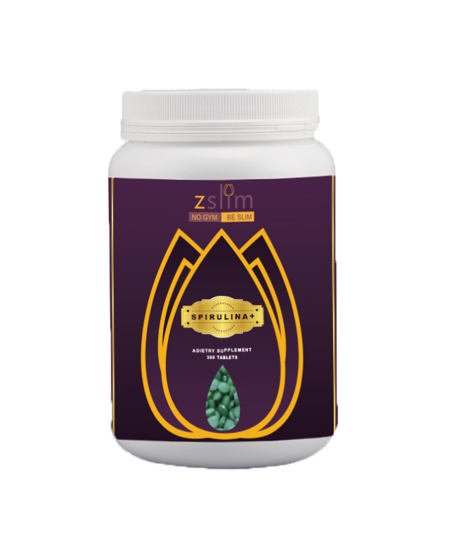
SPIRULINA +
SUPPLEMENT FACTS - Serving size 3 tables (1.5g) Serving per container 100
Amount per serving calories 5
% Daily Value * | % Daily Value *
Sodium 2mg | 1%
Potassium 20mg | 1%
Protein 1g | 2%
Vitamin A**1037IU | 21%
Vitamin B12 3.5mg | 58%
Calcium 9mg | 58%
Iron mg | 58%
*Percent Daily Values are bases on 2,000 Calories diet. Your Values may be Heigher or lower Depending on your calories needs **100% as Beta Carotene

Slide 14
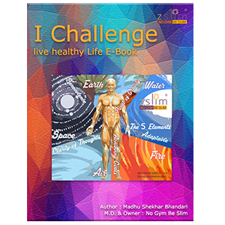
I CHALLENGE BOOK
What a striking similarity to planet which also has major portion covered with water. Isn’t it mystic? Yes it is, because nothing is by chance it all just reasserts the fact that we are one with the universe. The life comes to an end with death and most of the time is the result of a disease. So, this book was conceived to provide healthy life to people who are suffering from obesity, overweight, heart diseases, diabetes and similar ailments. A major component that plays a vital role in our well-being is food and during my research for an ideal way to healthy life I discovered that there are several natural sources of food which are rich minerals and vitamins. This book is a review of the select food items and also some natural ways to live a healthy and fit life. I decided to delve deep into the problems that trigger unhealthy state and cause diseases. So this book will talk about human beings and their body. A famous quote says that “The body is the most flexible agenda of life which means how we mold our body, decides what we achieve in our life.

Slide 15
I CHALLENGE E-BOOK
This book is a unique amalgamation of theoretical learning and practical experience which I gained while experiencing an approach towards healthy Life. I have compiled these experiences and written a book in simple language for easy understanding of what life is all about and how we can achieve the goal of a healthy life. The human body consists of elements like water which constitutes 75% of the body mass and the rest 25% consists of hard core minerals and elements like Oxygen, Silicon, Calcium, Aluminum, Iron etc.

Slide 16
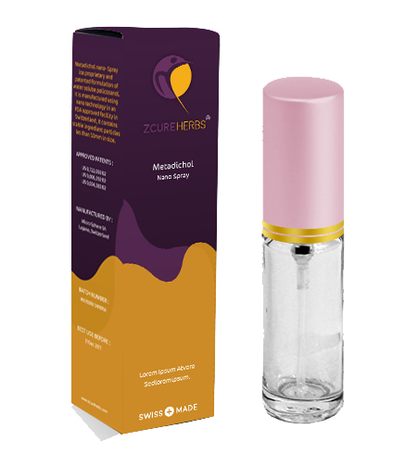
ZCURE SPRAY
Zcure is a proprietary and patented nutraceutical oral spray that has the ability to provide similar therapeutic effects of 1,25 Dihydroxy vitamin D3, stimulate the immune system, enhance wound healing, facilitate gene transcription, correct the underlying health problems and inhibit a wide range of disease processes. It is a branded formulation of Water-Soluble Policosanol and has a particle size less than 50 nm. In human studies, Zcure has been shown to target and improve key biomarkers implicated in diabetes,hyperlipidemia,obesity,infection,inflammation, cardiovascular disease, cancer, kidney disease, blood disorder and auto immune diseases.

Slide 17
ZCURE SPRAY
Zcure supports whole body homeostasis and it is effective for long term health maintenance. Zcure Policosanol Nano Spray – the amazing Doctor Z in a bottle!
Zcure and Nano-Particles

Slide 18
ZCURE in action
Increases vitamin C & Adiponectin levels.
Decreases NF-KB and TNF- α levels.
Corrects for other imbalance biomakers.
Generates pluripotent stem cells to repair damaged cells, blood vessels and scar tissues.
Modulates the immune systems and improves immune and physiological functions.

Slide 19
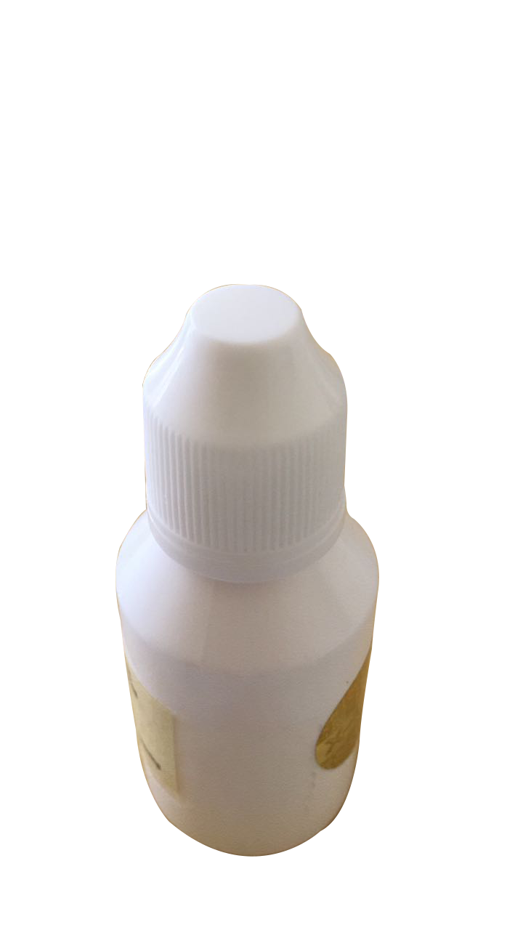
Nano Curcumin
Turmeric is an important edible and medicinal herb which has been used since centuries to treat several diseases like arthritis, pain, bruises, eye problems, gastrointestinal problems, worms, swelling, cancer and many more.
Curcumin, a low cost, non toxic active ingredient in turmeric is responsible for its characteristic colour, odour and therapeutic anti oxidant and anti inflammatory properties.
Nanocurcumin is a modified form of curcumin in which the particles of curcumin are transformed into nanoparticles that are more soluble and deliverable in the body.

Slide 20
Dietician
The best thing to happen to the nutrition scene in world to cater to the specific and general needs of each and every individual. A most descriptive advice for nutrition and dietetics information, therapeutic diets, low calorie recipes, tailored diet plans suiting individual requirements and expert advice by NGBS nutritionists and dieticians online or at NGBS Health stores. Also available are Customized Diets, Weight Loss Programmes.

Slide 21
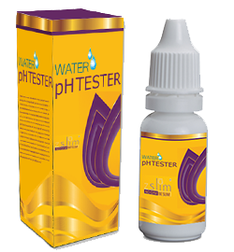
Ph tester
The pH of the body is largely influenced by metabolic by products and our diet. Thus, pH is directly affected by the various categories of food that we eat and the internal mechanisms involved in their processing. Some foods that are acid in their composition can become alkalizing following metabolizing by the body, such as lemons. Accordingly, it is to become more aware of the impact that various foods and our eating habits have on the internal environment of the body.
The scale that is used for measuring the pH, or hydrogen ion concentration, is from 0 to 14, with 7 being the neutral point. Below 7 is acidic; above 7 is alkaline. The optimal ph of the body’s fluids, such as the blood is 7.4, slightly alkaline.If deviated from this range, the bodies activity is no longer optimal and the metabolism is out of balance as the body will begin to store toxins in fat and move around acidic material to keep the blood PH in balance.

Slide 22
Ph tester
The pH of the body is largely influenced by metabolic byproducts and our diet. Thus, pH is directly affected by the various categories of food that we eat and the internal mechanisms involved in their processing. Some foods that are acid in their composition can become alkalizing following metabolizing by the body, such as lemons. Accordingly, it is to become more aware of the impact that various foods and our eating habits have on the internal environment of the body.

Slide 23
R.E.C. BREATHING technique (Session1) Mudras (session 2) (VIDEO)
WHAT DOES R.E.C. STAND FOR ?
“Enhance the energy which is lying inside you , you can only achieve the goal of your life once you'll be able to enlighten your soul”.
Music therapy is one of the expressive therapies, consisting of a process in which we use music and all of its facets—physical, emotional, mental, social, aesthetic, and spiritual—to help a person improve his or her psychological and biological health.

Slide 24
R.E.C. BREATHING technique (Session1) Mudras (session 2) (VIDEO)
In this DVD, in the first half of the session, we'll practice R.E.C. BREATHING TECHNIQUE, to purify the blood flow of our body. R.E.C. BREATHING TECHNIQUE is a word meaning Rejuvenating , Energizing , & Cleansing i.e. “putting new life”, "electrifying”or, "to free from the dirt”.This Breathing cycles gives a vital energy ,a life force ,when we breathe- in & breathe-out.
When we breathe differently, different emotions dilutes in a person and as a result past deposited karma get released from the subconscious , and our body and soul helps us to begin a fresh start, with a much purified Body and Mind.

Slide 25
R.E.C. BREATHING technique (Session1) Mudras (session 2) (VIDEO)
When we starts almost a new – life , with a fresh energy system, it helps to enhance our will –power and a person can do miracles. In the VIDEO , shown in this DVD, we have tried to visualize the most peaceful environment, where a person can gain a maximum result by doing this 27 minutes long session of Breathing Exercise. While practicing, try to feel yourself sitting near the seashore & feel the cold breeze running all over.
A MUDRA is a symbolic or ritual gesture in Hinduism & Buddhism. Some Mudras involve the entire body & most are performed with hands & fingers. It is an energetic seal of authenticity employed in the iconography & spiritual practice. The Mudras are used in conjunction with breathing exercises , generally in sitting pose, to stimulate.
WHAT DOES SESSION 2 OF THIS DVD HIGHLIGHTS? MUDRAS- HAND GESTURE

Slide 26
R.E.C. BREATHING technique (Session1) Mudras (session 2) (VIDEO)
different parts of the body involved with breathing and to affect the flow of life in body. The physical body is made up of Five Elements namely- Air, Water, Fire, Earth & Space. Imbalance of these 5 Elements disrupts the immunity system and cause diseases.
Deficiencies in any of these Elements can be made up by connecting one part of the body with another in a particular manner through MUDRAS, The 5 Fingers for 5 Elements are as follows: Thumb for Fire; Index for Air; Middle for Space; Ring for Earth ; Little for Water. When a finger representing an element is brought in contact with the thumb, the element is brought into balance. Therefore the disease caused by the imbalance is cured.

Slide 27
R.E.C. BREATHING technique (Session1) Mudras (session 2) (VIDEO)
Mudras start electromagnetic current within the body, which balances various constituting elements & restore health. The joining of fingers create an effect on the human body.

Slide 28
The 5 ELEMENTS (Audio)
WHAT IS THE SIGNIFICANCE OF THIS MUSIC WITH CLASSICAL RAAGAS’ ?
Music is mantra.It not only vibrates and soothes the mental strings, but also heals the organs of the body while establishing a harmony among them.
This is how classical music generates new hope, joy and enthusiasm in the otherwise dull or depressed mind; and removes the disorders and relieves one of the untoward pressures and excitements of inferiority, despair, fear and anger. Because of its fast remedial effects, Music Therapy based on classical Ragas is being advised these days for the treatment of insomnia, migraine, hypertension, chronic headache and anxiety. Music therapy, while bringing an equilibrium between body and mind, ensures effective treatment of the psychosomatic disorders.

Slide 29
The 5 ELEMENTS (Audio)
In this DVD, you will find the Classical Indian Music, which is beautifully composed on all the 5 ELEMENTS of our body. Through this music, we NGBS has taken an initiative to heal your entire body & mind that leads to awakening of the soul.
Human body is a perfect combination of five natural elements, which are known as EARTH, WATER, FIRE, AIR & SPACE.
It depends on combination of different inputs such as food we eat, water we drink, the air we breathe, the fire of the stomach which helps digest the food, & the emptiness of the space inside us which helps us to rejuvenate through breathing and meditation. Our mind gets better relaxed when we are near to these five elements. Please close your eyes & sit in a peaceful environment.Concentrate on the single tune of this Classical music , designed in such a way , which will open the DOORS of your FATE.

Slide 30
Antioxident alkaine healing structured water
Antioxident alkaine healing structured water

Slide 31
z.Slim capsules
( Future Development )
Benefits of Z-SLIM SLIMMING Capsules
Caralluma Fimbriata → Reduces appetite.
Gercinia Cambogia → Reduces body mass.
Green Tea → Burn fat by boosting your metabolism.
Boerhavia diffusa → Reduces Edema (swelling).
Trigonella Foenum Graceum → Help to maintain healthy sugar and cholestrol labels.
Syzygium Cumini Seen → Reduces blood and control sugar carvings.
Drugs free with no side effect.

Slide 32
z.Slim capsules
( Future Development )
Z-SLIM SLIMMING Capsules provides a means for weight management in the form of a polyherbal composition comprising Caralluma Fimbriata, Garnicia Cambogia, Boerhavia Diffusa, Green Tea, Trigonella Foenum Graceum, Syzygium Cumini Seed & Chromium. The reduction in weight can be achieved through reducing appetite, reducing edema (swelling), normalizing blood glucose levels, decreasing fat synthesis, enhancing metabolism, thereby lowering the risk of type 2 diabetes mellitus and subsequently hypertension also.

Slide 33
NITRIC OXIDE
( Future Development )
NITRIC OXIDE ACTIVATOR is the most reliable way to restore optimal levels of NITRIC OXIDE. It is the only product that uses all of the body's systems known to produce NO. Experience for yourself the benefits of restoring your own NITRIC OXIDE back to healthy levels.
Helps to increase blood flow & circulation.
Helps to reduce fatigue & improve recovery.
May increase energy levels, decrease blood pressure & boost sexual performance.
Benefits:

Slide 34
NITRIC OXIDE
( Future Development )
Direction: Take 1 scoop with water or your favorite beverage twice daily on an empty stomach. Take the rest dose in the morning and the second dose one hour prior to workout. If workout is in the morning take the second dose a half hour prior to lunch. To maximize results, drink at least 64 oz of water daily.

Slide 35
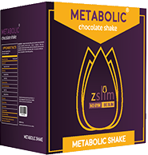
Metabolic
( Future Development )
The METABOLIC SHAKE is the cornestone of the METABOLIC system and your key to a quick and successful total body transformation. This delicious shake makes an excellent replacement for any meal. However, during weight loss it is most critical to take the shake for breakfast within two hours of waking.

Slide 36
Ngbs combo packs - 1
Ioniser 9
2 Bottles Zcure Spray
3 Bottles Spirulina +
Healing Music DVD
pH Tester
I Challenge Book
2 Bottles Nano Curcumin
Dietcian
Freight, Handling and Prefilters charges 400 USD

Slide 37
commission plan For Combo 1 – 4200 usd
10,000 UNITS | * 4200 | With 30% Commission | = 1,26,00000 USD
20,000 UNITS | * 4200 | With 30% Commission | = 2,52,00000 USD
50,000 UNITS | * 4200 | With 30% Commission | = 6,30,00000 USD
1,000,00 UNITS | * 4200 | With 30% Commission | = 12,60,00000 USD
5,000,00 UNITS | * 4200 | With 30% Commission | = 63,0000000 USD

Slide 38
Ngbs combo packs - 2
Ioniser 13
3 Bottles Zcure Spray
4 Bottles Spirulina +
I Challenge Book
Healing Music DVD
pH Tester
3 Bottles Nano Curcumin
Dietcian
Freight, Handling and Prefilters charges 400 USD

Slide 39
commission plan for Combo 2 – 5200 usd
10,000 UNITS | * 5200 | With 30% Commission | = 1,56,00000 USD
20,000 UNITS | * 5200 | With 30% Commission | = 3,12,00000 USD
50,000 UNITS | * 5200 | With 30% Commission | = 7,80,00000 USD
1,000,00 UNITS | * 5200 | With 30% Commission | = 15,60,00000 USD
5,000,00 UNITS | * 5200 | With 30% Commission | = 78,0000000 USD

Slide 40
World Market Prices
Product Name | Our Price | Market Price
Ioniser 9 | 2800 USD | 5000 USD
Ionizer 13 | 3800 USD | 6000 USD
Zcure Spray - Patented | 135 USD | Not Available
4 Bottles Spirulina + | 60 USD Each | 60 USD Each
Book | 11 USD | Not Available
Healing Music DVD | 60 USD | Not Available

Slide 41
World Market Prices
Product Name | Our Price | Market Price
pH Tester | 6 USD | 6 USD
NGBS Pectin | 200 USD | 200 USD
Dietician | 400 USD | 400 USD
Freight Charges | 400 USD | 400 USD
Nano Curcumin | 150 USD | 150 USD

Slide 42
World Market Prices
Product Name | Our Price | World Price
Ioniser 13 | 3800 USD | 6000 USD
Nano Curcumin | 150 USD | 150 USD
Dietician | 400 USD | 400 USD
pH Tester | 400 USD | 400 USD
I Challenge Book | 11 USD | Not Available
Healing Music DVD | 60 USD | Not Avilable
Zcure Spray | 135 USD | Not Available
Spirulina + | 60 USD | 60 USD
Freight Charges | 400 USD | 400 USD
5,016 USD
7,410 USD

Slide 43
World Market Prices
Product Name | Our Price | World Price
Ioniser 9 | 2800 USD | 5000 USD
Nano Curcumin | 150 USD | 150 USD
Dietician | 400 USD | 400 USD
pH Tester | 400 USD | 400 USD
I Challenge Book | 11 USD | Not Available
Healing Music DVD | 60 USD | Not Avilable
Zcure Spray | 135 USD | Not Available
Spirulina + | 60 USD | 60 USD
Freight Charges | 400 USD | 400 USD
4,466 USD
6,460 USD

Slide 44
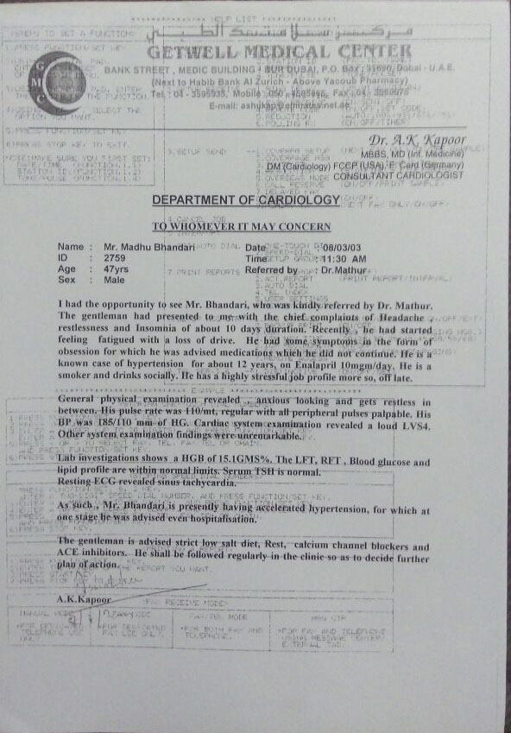
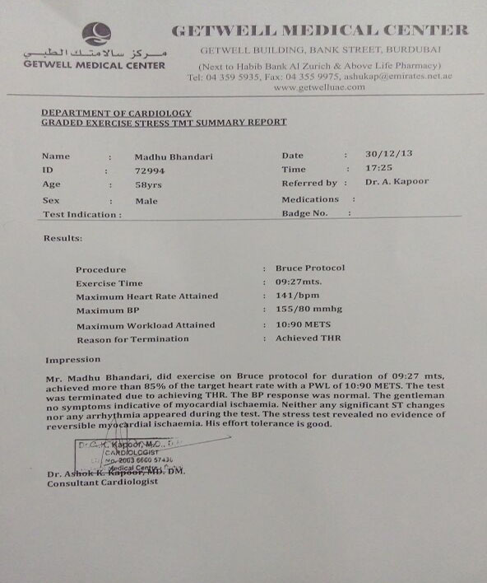
Doctor’s reports

Slide 45
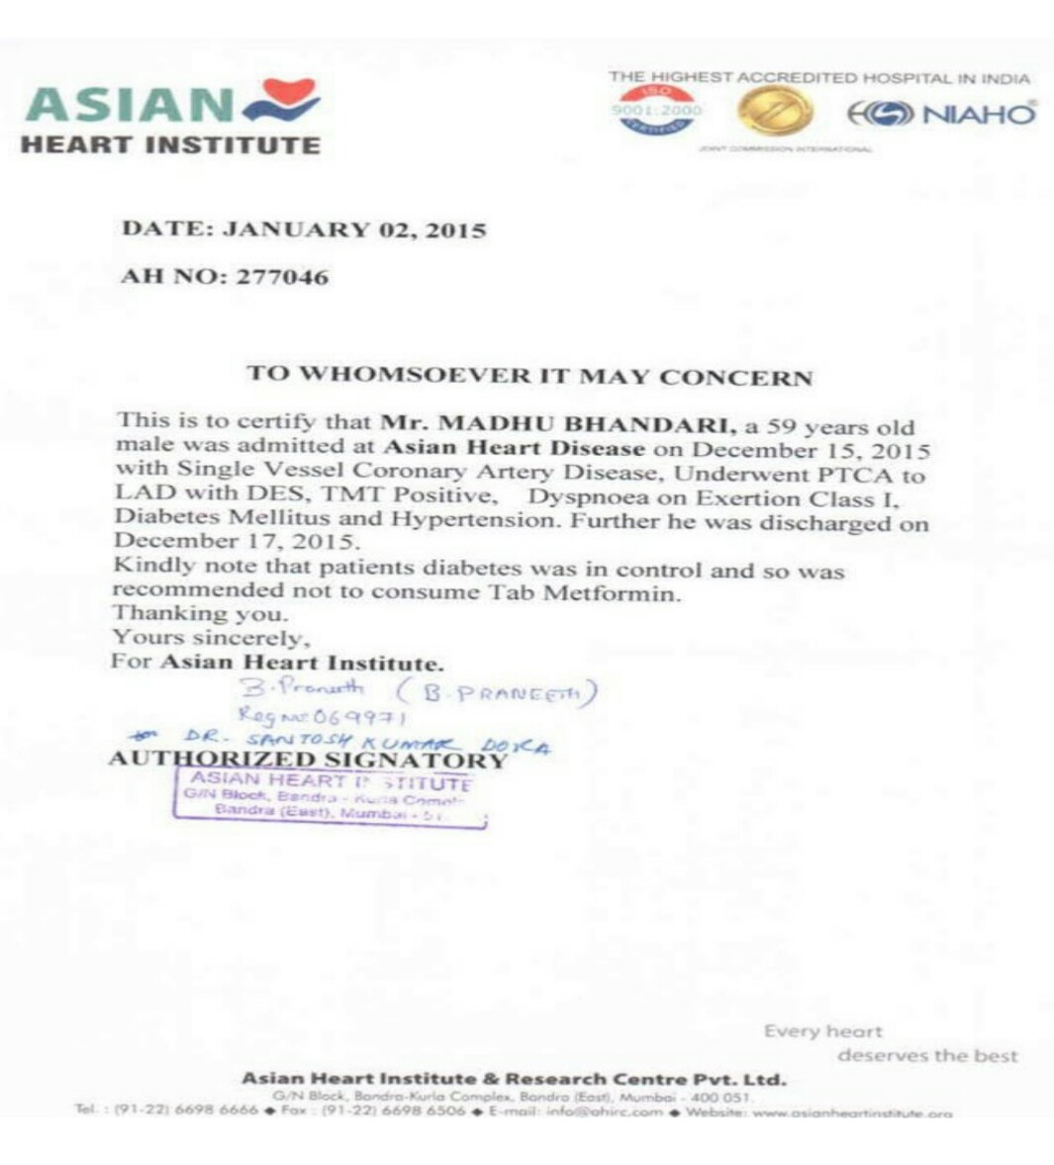
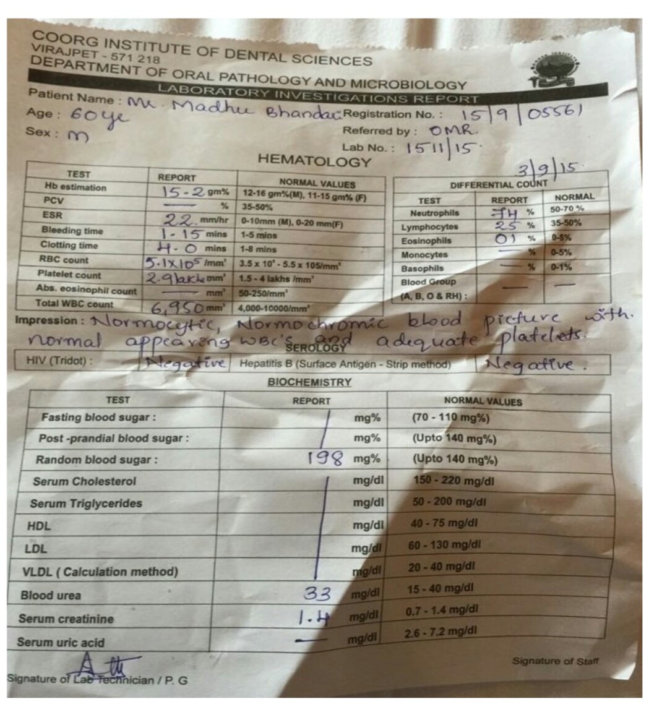
Doctor’s reports

Slide 46
Fifth Element, The Space ( Sky).
The space surrounds us and represents things beyond, composed of pure energy. You have your own thoughts & creative energy. The philosophers set themselves to penetrate into the sky and get lost in the emptiness within them. This elevates them to generate the power to invent …the power to create … This music will help you to explore the space within you. As a result, you will be able to explore the ability to think, create, invent and express higher values such as compassion, benevolence & wisdom.This music is composed in Raag Girwani. The live instruments used in this music are Mandolin, Santoor, Guitar etc.

Slide 47
second Element, The air
This is the element that connects all other elements, even though it might seem less relevant, invisible as it is. The distance from the nature of Earth lifts us up high, in impractical and mental planes that don’t satisfy our physical needs. Still, this is the element that can be found in all others, keeps the fire going just like the Sun burns hydrogen. We may say that the beginning of life wouldn’t be possible without Fire, but there would be no Fire on our planet without Air.

Slide 48
Third Element, The fire
A Fire sign is also an indicator of creativity. This element manifests itself in creative and unique ways, and those in its glow are wonderfully courageous and lively spirits. Those influenced by a Fire sign are self-sufficient, spontaneous and possess a tremendous zest for life.
It also stands to reason that a combustible Fire signer would be ardent in the game of love. Yes, these are the sexiest signs of the zodiac, knowing they are the cat's meow and climbing ever higher in the name of love. To their credit, those touched by Fire are often an inspiration to others, certainly for their adherence to solid moral and religious ideals.

Slide 49
Fourth Element, The Water.
It is the most vital ingredient for all forms of life. Blood and other bodily fluids represent water inside the human body. It is characterized as the fluid and flowing. In this music, just feel yourself becoming flexible, adaptable, supple, growing and changing according to the environment. The environment within you has to be tuned for harmony with the environment outside you.
This music is composed in Raag Mia Malhaar . The live instruments used in this music are Mandolin , Flute , Santoor , Guitar, etc. According to legend, Raag Malhar is so powerful that when sung, it can induce rainfall. It is possible that the rainfall that the legends speak of is in fact metaphorical of the state of mind brought about by the recital of the raag.

Slide 50
Fifth Element, The Earth
All the bones, flesh, muscles and tissues in our body symbolically represent The Earth. With this music, you can consciously feel the existence of your body & its steadiness. You would feel your mood to be highly resistant to movement or changes. This leads you to a mental state of stability and collectiveness prompting us to sense the point of gravity within us. This music is composed in Raag Darbari. The live instruments used in this music are Sitar, Santoor, Coir, Flute, Pakhwaj, Guitar etc.
Raag Darbari (Darbari Kaanada in Carnatic) and Bhairavi (SindhuBhairavi in Carnatic) are helpful in prolonging the state of meditation and thoughtless awareness. The notes of these raag help relax and calm the emotionally-related limbic area. The result is that one feels, joyous, energetic, peaceful and relieved of tension and depression. The person also enjoys the sensation of a cool breeze on the finger tips and achieves the state of Self-Realization or enlightenment.

Slide 51
Sixth Element, Dietician & Genetics Consultany from NO GYM BE SLIM
The best thing to happen to the nutrition scene in world to cater to the specific and general needs of each and every individual. A most descriptive advice for nutrition and dietetics information, therapeutic diets, low calorie recipes, tailored diet plans suiting individual requirements and expert advice by NGBS nutritionists and dieticians online or at NGBS Health stores. Also available are Customized Diets, Weight Loss Programmes.

Slide 52
One of the best solution for the human health to restored and prevent.

Slide 53
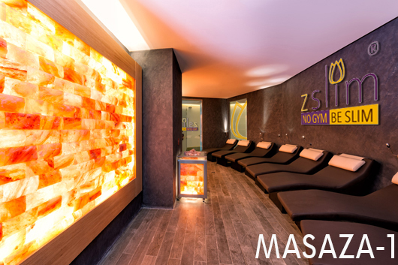
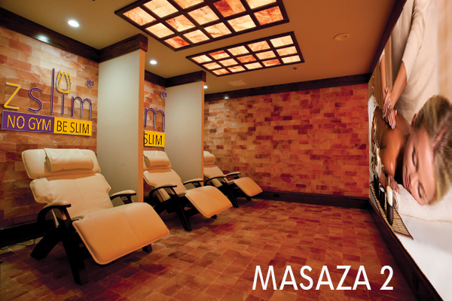
NGBS WEllness

Slide 54
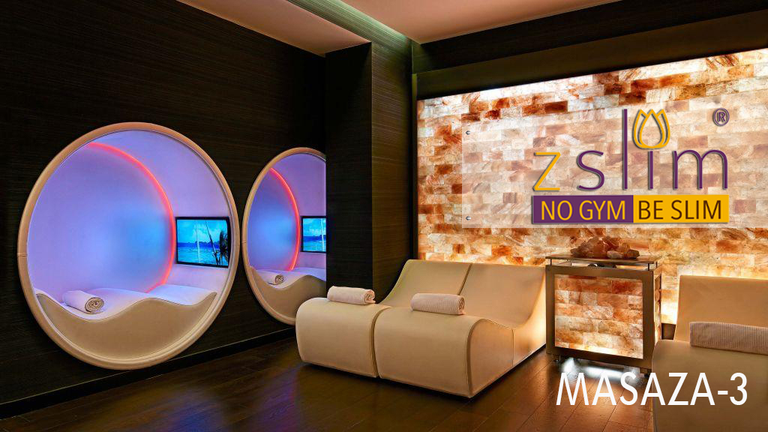
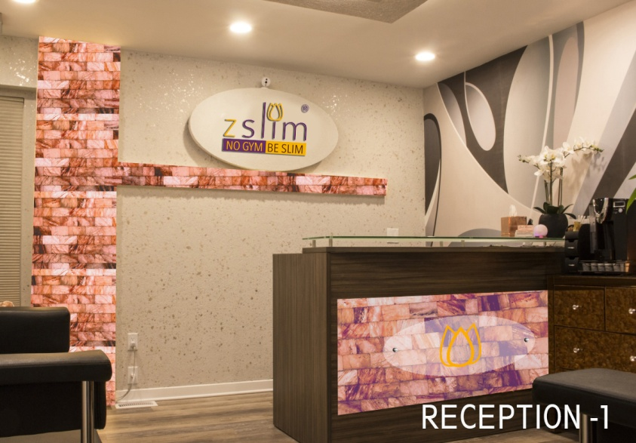
NGBS WEllness

Slide 55
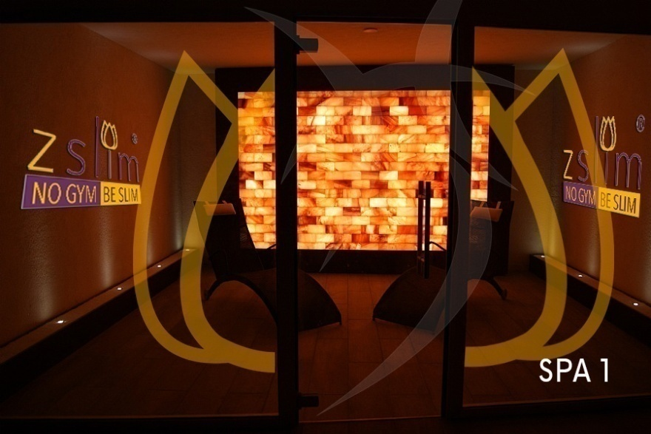
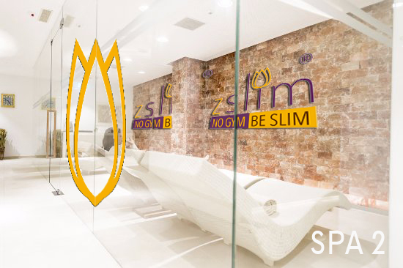
NGBS WEllness

Slide 56
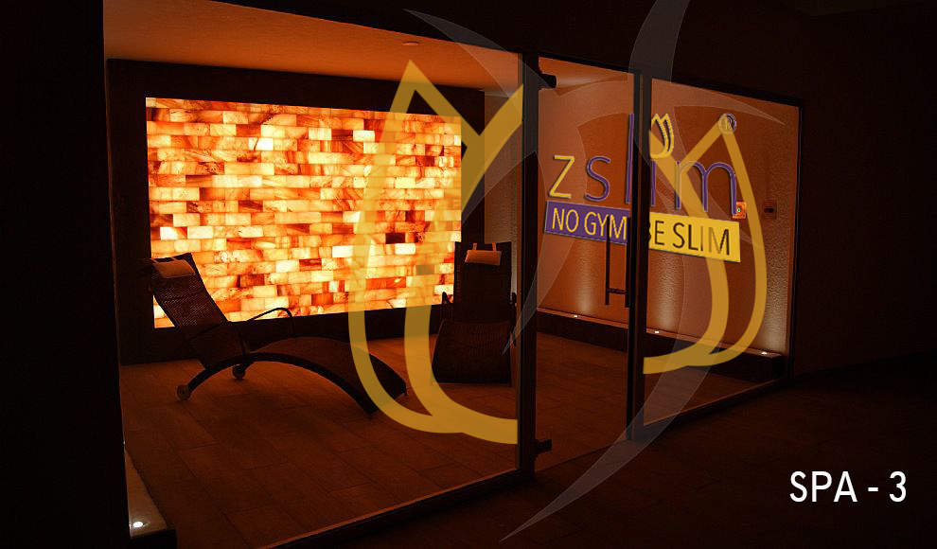
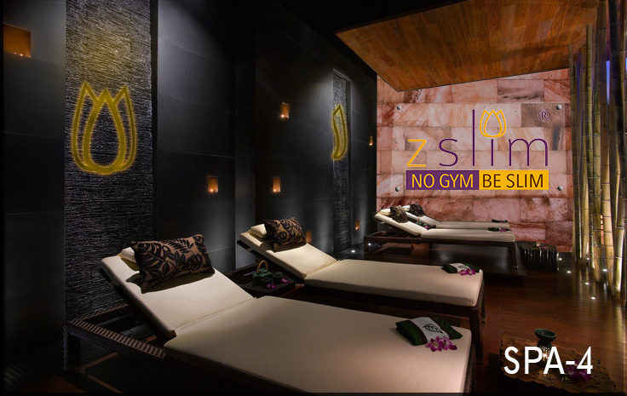
NGBS WEllness

Slide 57
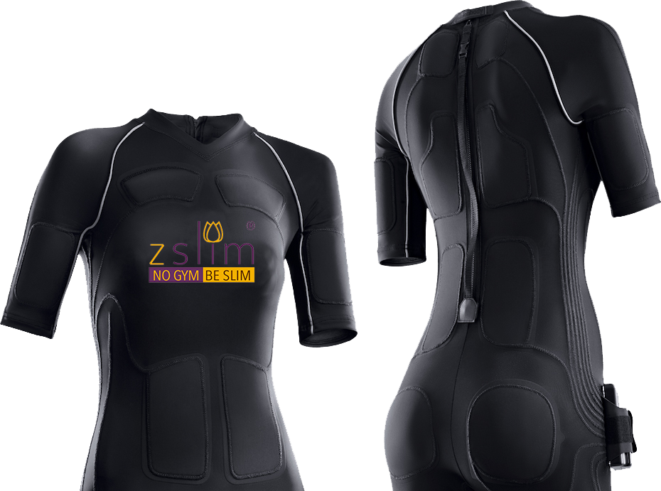
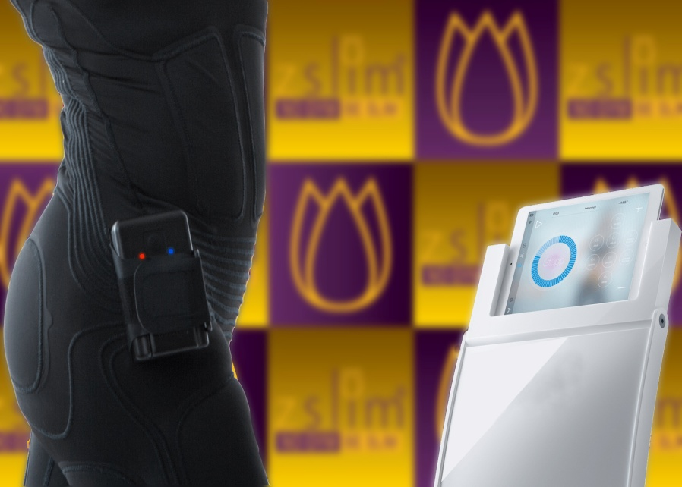
NGBS EMS – POWER suite

Slide 58
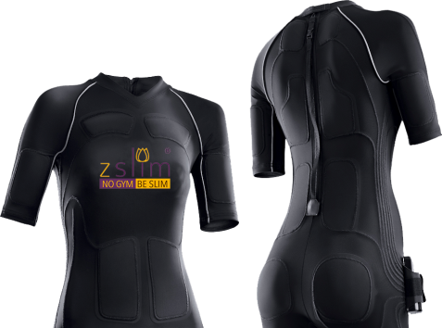
NGBS EMS – power suite
The antibacterial nature of the Nogymbeslim Powersuit guarantees maximum hygiene and a neutral odour. The material is also made to dry quickly. Yet it is so durable, washable without losing any of its functionality. It will give you years of enjoyment as your second skin.
The bi-elastic functional fabric moulds itself gently to your body and stays elastic in all directions. This offers your maximum freedom of movement during nearly any sport.Whether muscle-toning, endurance training or fat reduction, athletics, tennis or Pilates — Sport is a highly elastic term. So, it’s good that the Nogymbeslim Powersuit expands with you.

Slide 59
NGBS
Magnetic Resonant Diagnostics.
Healing Frequency.
Salt Therapy.
Live Sound Therapy.
Brain Correction.
Cleaning of health issue by subtle method.
Negative energy clearance and Positive energy enhancement.
Expected income ( 1 crore per year ) & Expecting setting up cost ( 2 to 2.5 crore).

Slide 60
NO GYM BE SLIM ,LLC Address: 501, Silver Side Road, 105 Suite Nos, Wilmington City, Delaware, 19809 USA Contact us: info@nogymbeslim.com/ product@nogymbeslim.com www.nogymbeslim.com
Thank You ☺

